Slide 1
Requirements Management
11

Slide 2
Content
Requirements Management Practices
Requirement Management Process
Requirements version control
Requirement attributes
Tracking requirements status

Slide 3


“I finally finished implementing the multivendor catalog query feature … Man, that was a lot of work!”
“Oh, the customers canceled that feature two weeks ago … Didn’t you get the revised SRS?”
“What do you mean, it was canceled? …
Those requirements are at the top of page 6 of my latest SRS.”
“Hmmm, they’re not in my copy. I’ve got version 1.5 of the SRS. What version are you looking at?”
“Mine says version 1.5 also …These documents should be identical, but obviously they’re not. So, is this feature still needed, or did I just waste 30 hours of my life?”

Slide 4
Requirements management
Having great requirements gets you only partway to a solution; they also have to be well managed and effectively communicated among the project participants.
Requirements management includes all activities that maintain the integrity, accuracy, and currency of requirements agreements throughout the project.

Slide 5
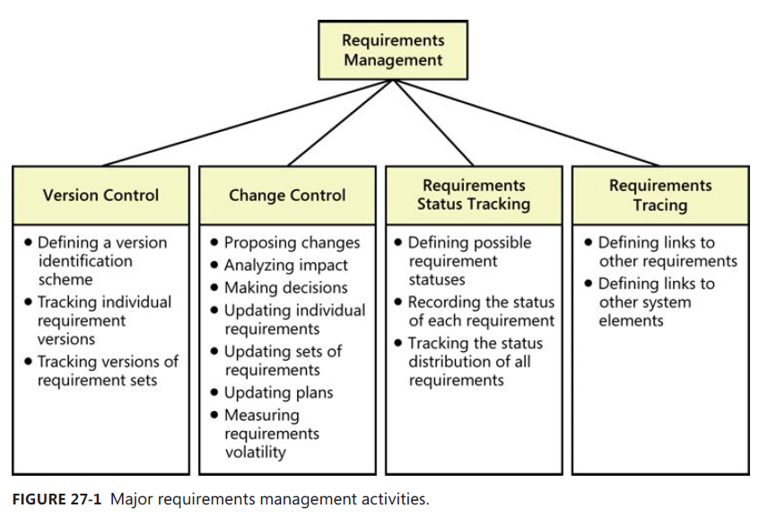
Requirements management activities
Core activities of requirements management in four major categories

Slide 6
Documenting requirements management activities
An organization should define the activities to manage requirements
Documenting activities & training people help in effective requirements management
Consider addressing the following topics:
Tools, techniques, and conventions for distinguishing versions of individual requirements and of requirements sets
The way that sets of requirements are approved and baselined
How new requirements & changes to existing ones are proposed, evaluated, negotiated & communicated
How to assess the impact of a proposed change
Requirement attributes and requirements status-tracking procedures
Who is responsible for updating requirements trace information and when
How to track and resolve requirements issues
How the project’s plans and commitments will reflect requirements changes
How to use the requirements management (RM) tool effectively
All this information can be put in a single requirements management process description OR separate version control, change control, impact analysis, and status tracking procedures can be maintained.

Slide 7
The requirements baseline
In requirement development, the related deliverables are reviewed and approved to make requirements baseline.
A requirements baseline is a set of requirements that stakeholders have agreed to, often defining the contents of a specific planned release or development iteration.
Subsequent changes can be made only through the project’s defined change control procedure.
Prior to baselining, the requirements are still evolving, so there’s no point in imposing unnecessary process overhead on those modifications.

Slide 8
Requirements version control
Version control, uniquely identifying different versions of an item, applies at the level of both individual requirements and requirements sets
Every version of the requirements must be uniquely identified.
Every team member must be able to access the current version of the requirements.
Changes must be clearly documented and communicated to everyone affected.
To minimize confusion and miscommunication, permit only designated individuals to update the requirements, and make sure that the version identifier changes whenever an update is made.

Slide 9
Requirement attributes
Think of each requirement as an object with properties that distinguish it from other requirements.
In addition to its textual description, each requirement should have supporting pieces of information or attributes associated with it.
These attributes establish a context and background for each requirement.
You can store attribute values in a document, a spreadsheet, a database, or a requirements management tool.

Slide 10
Requirement attributes
Following is a list of potential requirement attributes to consider:
Date the requirement was created
Current version number of the requirement
Author who wrote the requirement
Priority
Status
Origin or source of the requirement
Rationale behind the requirement
Release number or iteration to which the requirement is allocated
Stakeholder to contact with questions or to make decisions about proposed changes
Validation method to be used or acceptance criteria

Slide 11
Tracking Requirements Status
Status is one of the requirement attributes suggested.
Tracking status means comparing where you really are at a particular time against the expectation of what “complete” means for this development cycle.
Tracking the status of each functional requirement throughout development provides a more precise gauge of project progress.
The common “90 percent done” syndrome doesn’t tell much about how close an item is to completion.
Classifying requirements into several status categories is more meaningful than trying to monitor the percent completion of each requirement or of the complete release baseline.
Update a requirement’s status only when specified transition conditions are satisfied.

Slide 12
Tracking Requirements Status
Status | Description
Proposed | The requirement has been requested by an authorized source.
In Progress | A business analyst is actively working on crafting the requirement.
Drafted | The initial version of the requirement has been written.
Approved | The requirement has been analyzed, its impact on the project has been estimated, and it has been allocated to the baseline for a specific release. The key stakeholders have agreed to incorporate the requirement, and the software development group has committed to implement it.

Slide 13
Tracking Requirements Status
Status | Description
Implemented | The code that implements the requirement has been designed, written, and unit tested. The requirement has been traced to the pertinent design and code elements. The software that implemented the requirement is now ready for testing, review, or other verification.
Verified | The requirement has satisfied its acceptance criteria, meaning that the correct functioning of the implemented requirement has been confirmed. The requirement has been traced to pertinent tests. It is now considered complete.

Slide 14
Tracking Requirements Status
Status | Description
Deferred | An approved requirement is now planned for implementation in a later release.
Deleted | An approved requirement has been removed from the baseline. Include an explanation of why and by whom the decision was made to delete it.
Rejected | The requirement was proposed but was never approved and is not planned for implementation in any upcoming release. Include an explanation of why and by whom the decision was made to reject it.
Table: Suggested requirement statuses

Slide 15
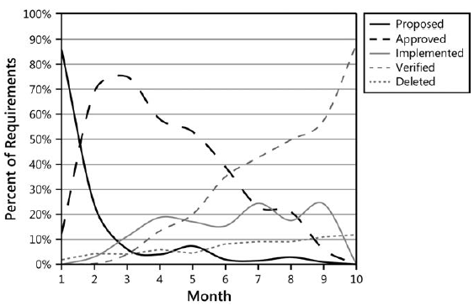
Visually monitoring requirements status

Slide 16
Resolving requirements issues
Numerous questions, decisions, and issues related to requirements will arise during the course of a project.
Potential issues include items flagged as TBD, pending decisions, information that is needed, and conflicts awaiting resolution.
It’s easy to lose sight of these open issues.
Record issues in an issue-tracking tool so all affected stakeholders have access to them.
Keep the issue-tracking and resolution process simple to ensure that nothing slips through.
Resolve requirements issues so they don’t impede the timely baselining of a high-quality requirements set for your next release or iteration.

Slide 17
Common requirement issues

Slide 18
Measuring requirements effort
As with requirements development, your project plan should include tasks and resources for the requirements management activities
If you track how much effort you spend on requirements development and management activities, you can evaluate whether it was too little, about right, or too much, and adjust your future planning accordingly.
Measuring effort requires a culture change and the individual discipline to record daily work activities.
Team members gain valuable insight from knowing how they actually spent their time, compared to how they thought they spent their time, compared to how they were supposed to spend their time.

Slide 19
Change Management
Software change isn’t a bad thing; in fact, it’s necessary!
The world changes as development progresses: new market opportunities arise, regulations and policies change, and business needs evolve.
It’s virtually impossible to define all of a product’s requirements up front.
An effective software team can respond to necessary changes so that the product they build provides timely customer value.
Requirements change management is a process of managing changing requirements during the requirements engineering process and system development.

Slide 20
Why Manage Changes?
An organization that’s serious about managing its software projects must ensure that:
Proposed requirements changes are thoughtfully evaluated before being committed to.
Appropriate individuals make informed business decisions about requested changes.
Change activity is made visible to affected stakeholders.
Approved changes are communicated to all affected participants.
The project incorporates requirements changes in a consistent and effective fashion.

Slide 21
Managing scope creep
Requirements growth includes new functionality and significant modifications that are presented after a set of requirements has been baselined
The requirements for software systems typically grow between 1 percent and 3 percent per calendar month
Some requirements evolution is legitimate, unavoidable, and even advantageous.
The problem is not that requirements change but that late changes can have a big impact on work already performed.
Scope creep happens when the project continuously incorporates more functionality without adjusting resources, schedules, or quality goals.

Slide 22
Managing scope creep
The first step in managing scope creep is to document the business objectives, product vision, project scope, and limitations of the new system so that every proposed requirement can be evaluated against them
The most effective technique for controlling scope creep is the ability to say “no”
People don’t like to say no to customers
The customer is always right philosophy is fine, but you pay a price for it.
Ignoring the price doesn’t alter the fact that change is not free.
You may say something like “not now” to make it sound more acceptable

Slide 23
Change Control Policy
Management should communicate a policy that states its expectations of how project teams will handle proposed changes in requirements and all other significant project artifacts.
Policies are meaningful only if they are realistic, add value, and are enforced.

Slide 24
Change Control Policy
The following change control policy statements can be helpful:
All changes must follow the process. If a change request is not submitted in accordance with this process, it will not be considered.
No design or implementation work other than feasibility exploration will be performed on unapproved changes.
Simply requesting a change does not guarantee that it will be made. The project’s change control board (CCB) will decide which changes to implement.
The contents of the change database must be visible to all project stakeholders.
Impact analysis must be performed for every change.
Every incorporated change must be traceable to an approved change request.
The reason behind every approval or rejection of a change request must be recorded.

Slide 25
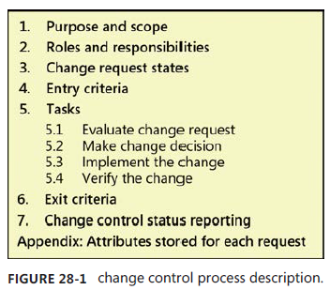
A change control process description
Figure illustrates a template for a change control process description to handle requirements modifications.
Purpose and scope
Describe the purpose of this process and the organizational scope to which it applies. Indicate whether any specific kinds of changes are released, such as changes in temporary work products.

Slide 26
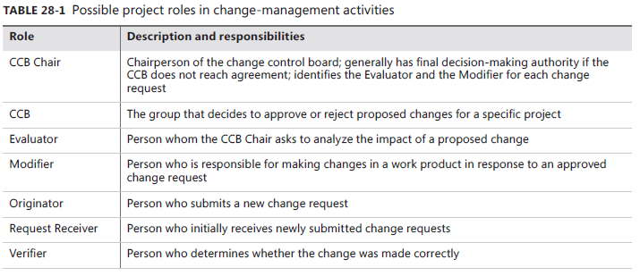
A change control process description
Roles and responsibilities

Slide 27
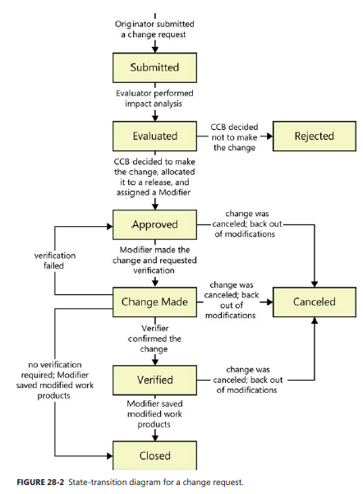
A change control process description
Change request status
A change request passes through a defined life cycle of states. You can represent these states by using a state-transition diagram, as illustrated in Figure .

Slide 28
A change control process description
Entry criteria
The conditions that must be satisfied before the process execution can begin
The basic entry criterion for your change control process is that a change request with all the necessary information has been received through an approved channel.
All potential originators should know how to submit a change request.
Change tool should assign a unique identifier to each request and route all changes to the Request Receiver.

Slide 29
A change control process description
Tasks
Evaluate change request
Begin by evaluating the request for technical feasibility, cost, and alignment with the project’s business requirements and resource constraints.
The CCB Chair might assign an Evaluator to perform impact analysis, risk and hazard analysis, or other assessments.
Make change decision
The appropriate decision makers, chartered as the CCB, then decide whether to approve or reject the change.
The CCB gives each approved change a priority or target implementation date, or it allocates the change to a specific iteration or release.

Slide 30
A change control process description
Tasks
Implement the change
The assigned Modifier (or Modifiers) updates the affected work products as necessary to fully implement the change.
Use requirements trace information to find all the parts of the system that the change touches, and revise the trace information if necessary to reflect the changes made.
Verify the change
Requirements changes typically are verified through a peer review to ensure that modified deliverables correctly address all aspects of the change.
Multiple team members might verify the changes made in various downstream work products through testing or review.

Slide 31
A change control process description
Exit criteria
the conditions that indicate when the process is successfully completed
Satisfying the following exit criteria indicates that an execution of your change control process was properly completed:
The status of the request is Rejected, Closed, or Canceled.
All modified work products are updated and stored in the correct locations.
The relevant stakeholders have been notified of the change details and the status of the change request.
Change control status reporting
Identify the charts and reports you’ll use to summarize the contents of the change database.
These charts might show the number of change requests in each state as a function of time, or trends in the average time that a change request is unresolved.

Slide 32
Summary
Whether your project is following a sequential development life cycle, one of the various agile life cycles, or any other approach, managing the requirements is an essential activity.
Requirements management helps to ensure that the effort you invest in requirements development isn’t squandered.
Effective requirements management reduces the expectation gap by keeping all project stakeholders informed about the current state of the requirements throughout the development process.
It lets you know where you’re headed, how the trip is going, and when you’ve arrived at your destination.

